Slide 1

HOTEL MANAGEMENT SYSTEM

Slide 2
THÀNH VIÊN
Student1501281 | Nguyen Nhat Nam
Student1501843 | Tran The Anh
Student1501200 | Pham Minh Tri
Student1501052 | Nguyen Quang Thinh

Slide 3
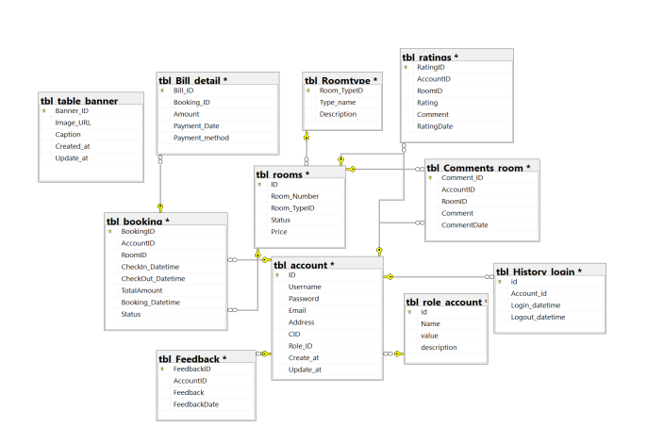
DATABASE

Slide 4
DATABASE

Slide 5
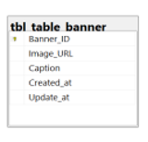
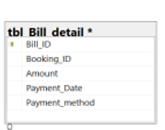
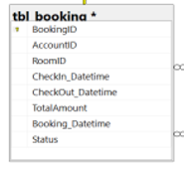
Nguyen Nhat Nam

Slide 6
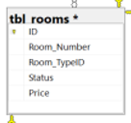

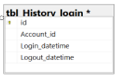
Tran The Anh

Slide 7
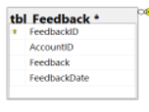
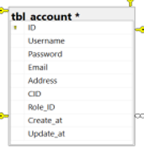
Pham Minh Tri

Slide 8
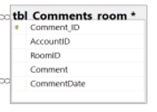
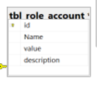
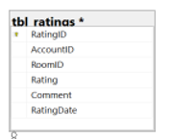
Nguyen Quang Thinh

Slide 9
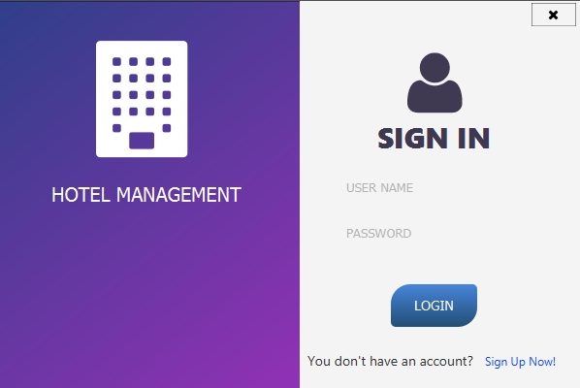
Register an account
- Click Sign Up Now! button at the bottom to register as user.

Slide 10
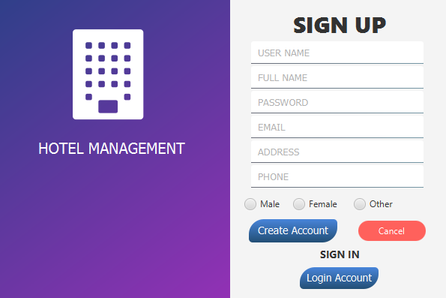
Register an account
- Enter personal information to register form, then click “Create Account” button

Slide 11
Nguyen Nhat Nam
Login to your account
- Click “Login Account” button at the bottom, then enter email and password match to registered account, then click “Login”.

Slide 12
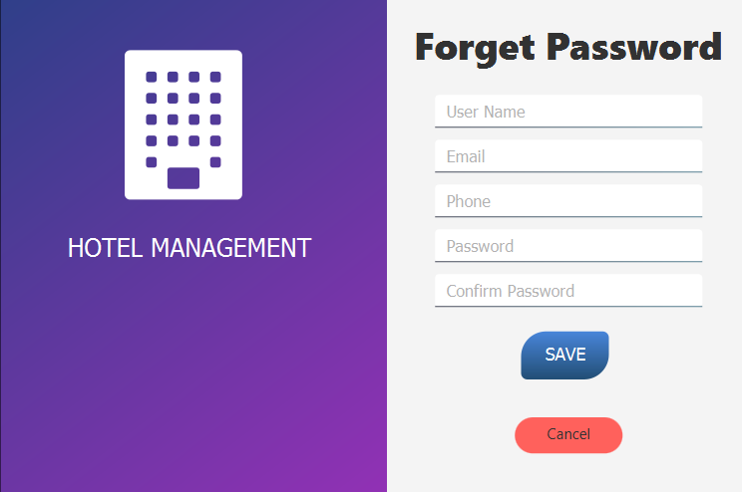
Nguyen Nhat Nam
Forget password

Slide 13
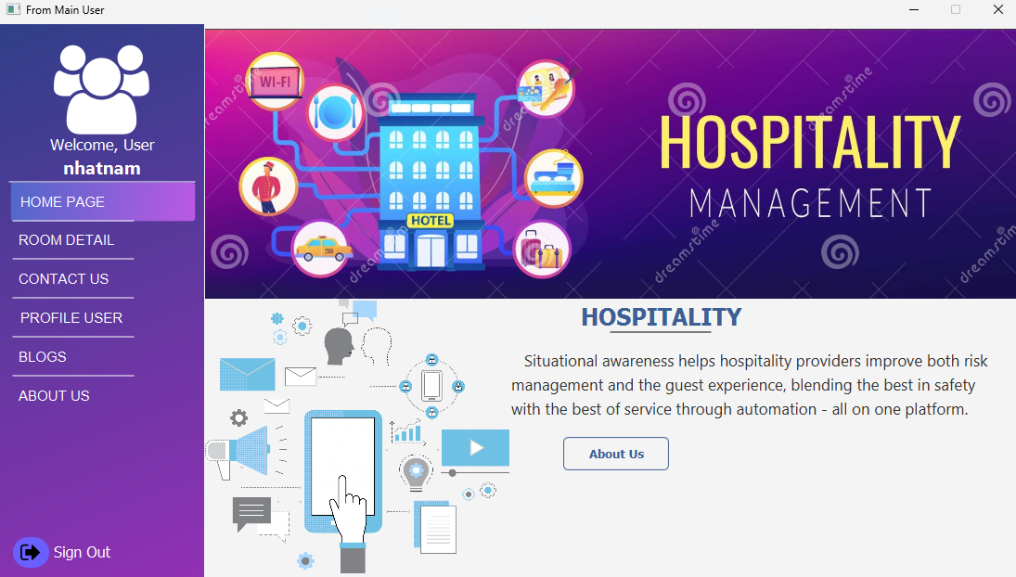
Nguyen Nhat Nam
Home page

Slide 14
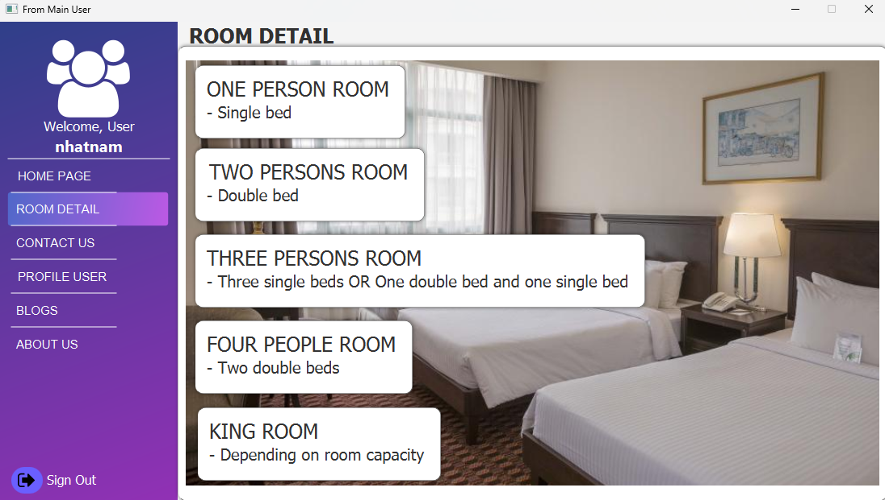
Tran The Anh
Room detail

Slide 15
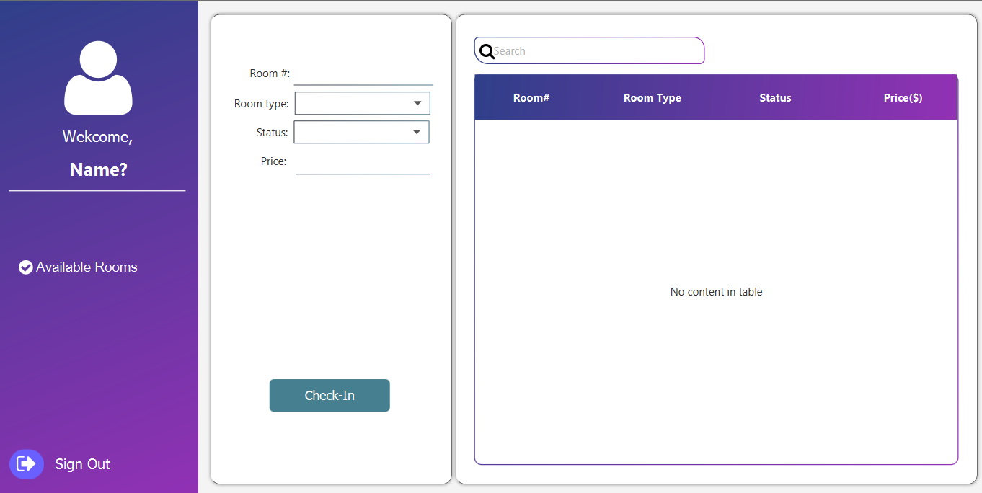
Tran The Anh
Room detail

Slide 16
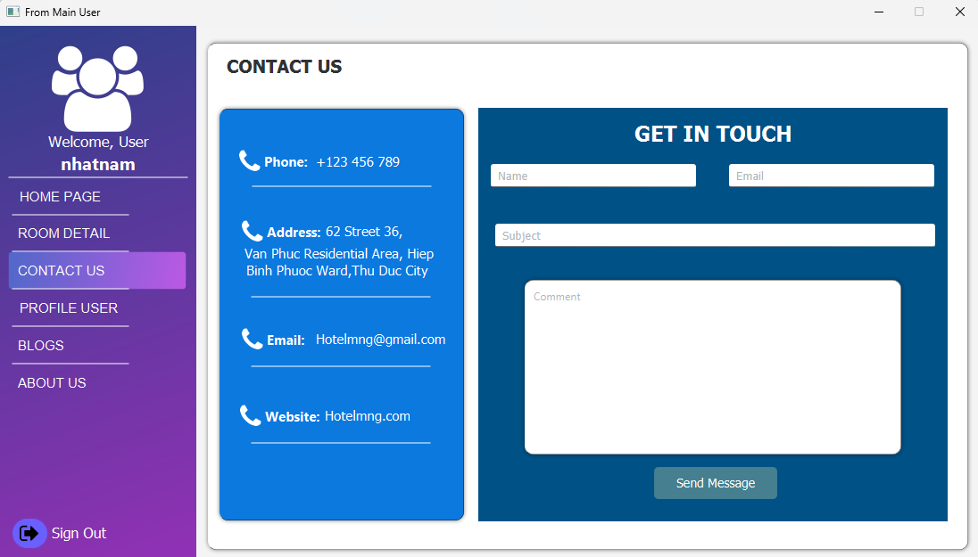
Tran The Anh
Contact us

Slide 17
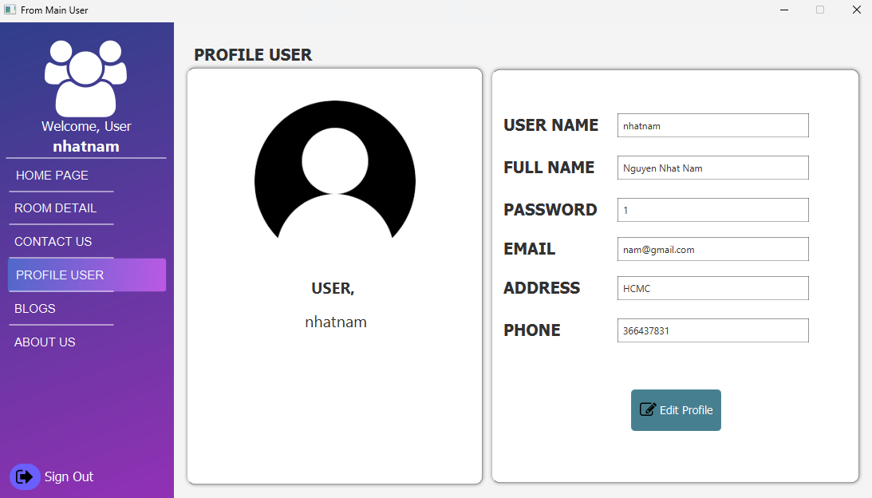
Pham Minh Tri
Profile user

Slide 18
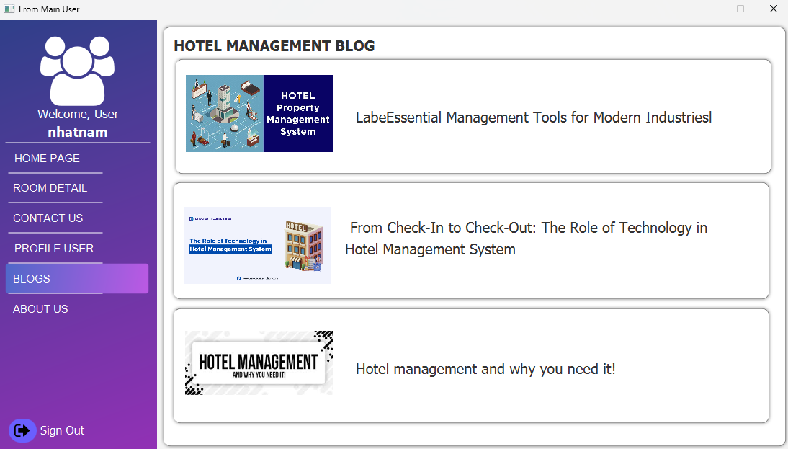
Pham Minh Tri
Blogs

Slide 19
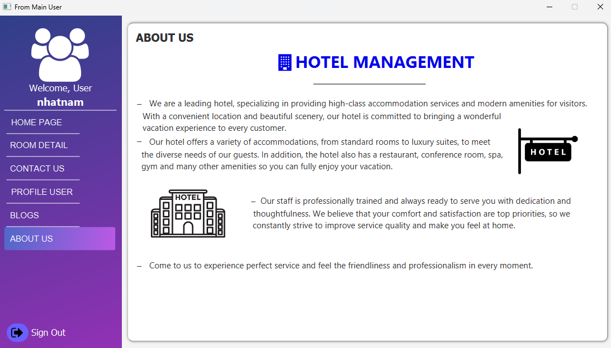
Pham Minh Tri
About us

Slide 20
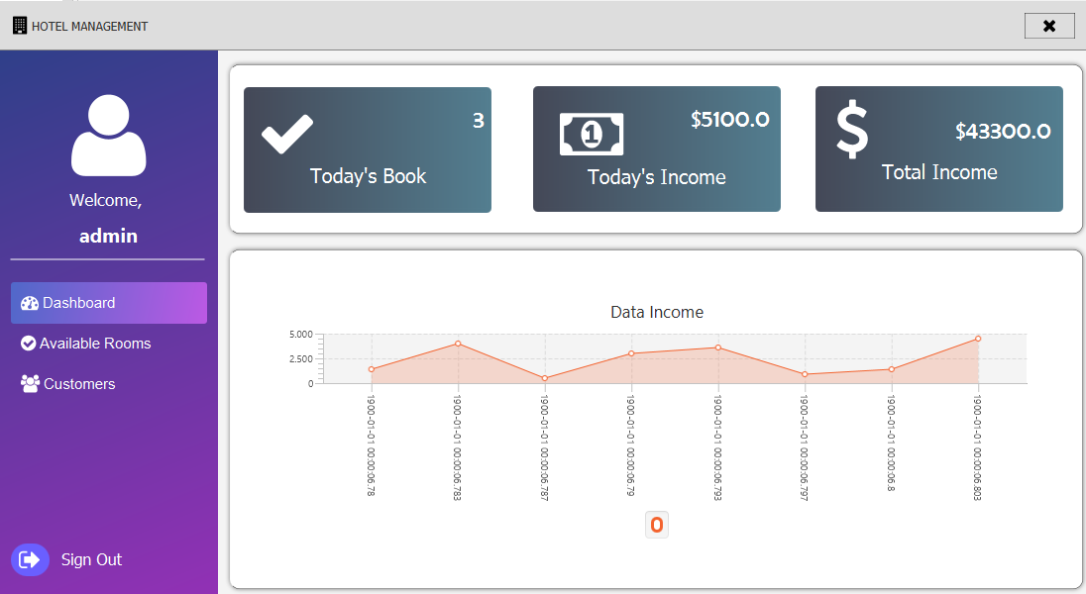
Pham Minh Tri
Main dashboard page
Display overall information of website in nearest 30days, click to More info in each card to view more detail. The side bar include route to all managegement page of each class.

Slide 21
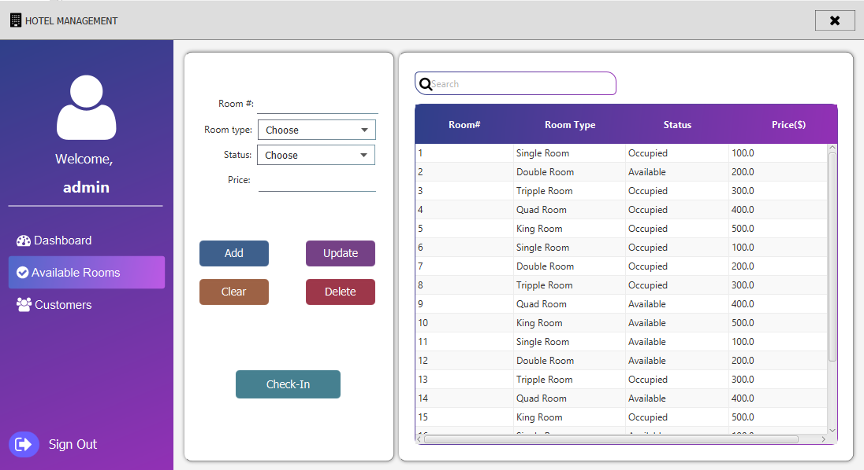
Nguyen Quang Thinh
Available Rooms
Click on Categories button on sidebar to redirect Available Rooms page:

Slide 22
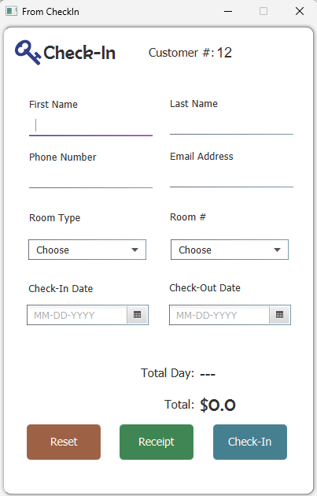
Nguyen Quang Thinh
Available Rooms
Admin can manage Rooms on this page: add new Rooms, edit or delete existing rooms and Check-In.

Slide 23
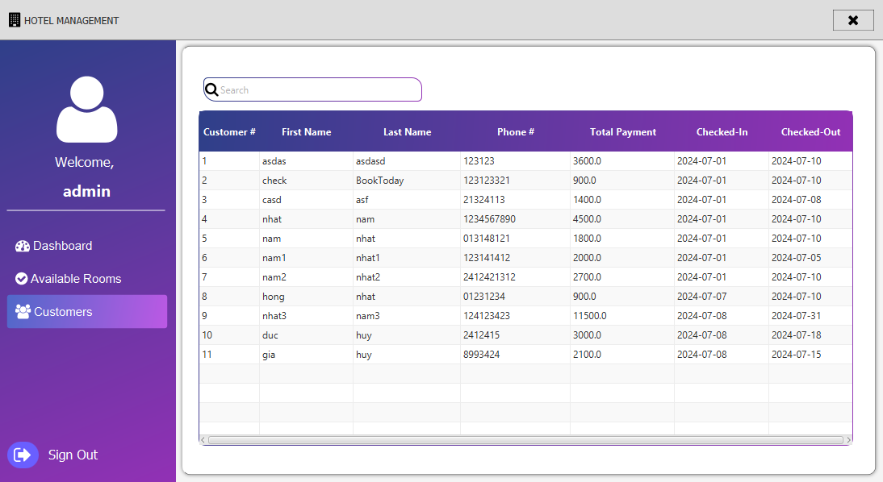
Nguyen Quang Thinh
Customers
Click on Customers button on sidebar to redirect Customers page. Admin can search Customer information in this page

Slide 24

THANK YOU

